Slide 1

Capstone Project — Technical Evaluation Presentation
Wipro Network Management System
COGNINENT – AI POWERED NETWORK FAULT AND ROOT CAUSE ANALYSIS SYSTEM
Project Team
Guided By
230701138 — Kamalesh SP
230701158 — Kumaran R
230701414 — Ganesh M
[MENTOR NAME]

Slide 2

PROBLEM STATEMENT
Challenges in Monitoring and Managing Network Infrastructure
Modern network environments contain multiple devices, interfaces, and continuously changing operational information. As the network grows, manually observing device health, interface conditions, and network events becomes increasingly difficult.
Limited Device Visibility
Manual Interface Monitoring
Telemetry Management
Network administrators need a centralized view of managed network devices and their operational status. When information is distributed across individual devices, obtaining an overall view of network health becomes difficult.
Network devices contain multiple interfaces whose operational states can change. Checking individual interfaces manually increases monitoring effort and makes continuous observation difficult.
Network operational information — interface status, device information, and performance metrics — needs to be collected, processed, and stored systematically.
Delayed Fault Detection
Unstructured Alarm Tracking
Inconsistent Fault Tracking
An interface or device can transition from a normal state to a failed state. Without continuous monitoring and processing, such conditions may not be identified immediately.
Identifying a fault is only the first step. The fault needs to be recorded, tracked while active, and cleared when the underlying condition is resolved.
Active, recurring and resolved network conditions can be difficult to track systematically and the effort required for continuous monitoring.
CORE PROBLEM: How can network devices, interfaces, telemetry, and faults be monitored through a single centralized Network Management System?
Flow: Multiple Network Devices → Distributed Information → Manual Monitoring → Delayed Fault Detection → Operational Difficulty

Slide 3


PROPOSED SOLUTION
WIPRO NMS — Centralized Network Monitoring, Telemetry and Alarm Management
WIPRO NMS is a centralized Network Management System designed to bring network device information, interface monitoring, telemetry processing, and alarm management into one unified platform. The system addresses each of the five core challenges through dedicated capabilities.
Device Management
Interface Management
Telemetry Monitoring
Maintains centralized information about managed network devices: device identity, hostname, IP address, device type, operating information, and device association with interfaces. Provides a centralized inventory and operational view of managed network devices.
Maintains information about individual network interfaces: interface identity, name, IP address, associated device, and operational status. Provides visibility into the operational state of individual interfaces.
Processes network monitoring information including interface operational status, device status, CPU metrics, memory metrics, interface traffic, and other network telemetry. Converts network activity into structured monitoring information.
Alarm Management
Centralized Dashboard
AI-Powered Network Intelligence
Manages abnormal network conditions through a structured alarm lifecycle: alarm creation, updates, active alarm deduplication, alarm reopening where applicable, alarm clearing, and first-seen/last-seen tracking. Provides structured visibility into network faults and their current state.
The web interface provides a unified operational view of devices, interfaces, telemetry, alarms, and network status.
Analyzes network data and alarms to detect anomalies, perform root-cause analysis, reduce alarm noise, predict potential failures, and explain incidents to the operator.
Plan
Create
Review
Deploy

Slide 4
SYSTEM COMPONENTS
WIPRO NMS — System Components and Working
The six core components of WIPRO NMS work together to deliver end-to-end network monitoring, from simulation and telemetry ingestion to alarm handling, persistence, and dashboard visualization.
1. Network Simulation — GNS3 + FRRouting
4. Telemetry Processing
GNS3 provides the virtual lab environment used to build and validate the topology before deployment. The simulated routers (R1, R2, R3) run FRRouting, advertise routes, exchange traffic, and expose real interface states such as link up/down, administrative status, and routing adjacency changes. This lets the NMS observe realistic device behavior without requiring physical hardware.
Role: Create the network topology, emulate routers and links, generate operational events such as interface failures or route changes, and provide a controlled environment for testing monitoring and alarm logic.
Example data source: R1 ←→ R2 ←→ R3, with each router exposing interface counters, reachability, and protocol state that the NMS can poll or receive via telemetry.
Telemetry received by the system is processed by backend services in a multi-step pipeline. The backend first parses the payload, identifies the metric name and timestamp, associates it with the correct device and interface, and then applies metric-specific interpretation rules. For example, interface_oper_status = 1 is translated to UP, while interface_oper_status = 0 is translated to DOWN. Similar logic can be applied to CPU thresholds, memory pressure, and traffic spikes to determine whether the observation is normal or requires attention.
Processing steps: receive telemetry → validate payload → identify metric → map to device/interface → persist raw and processed values → evaluate state transition → emit monitoring result.
Example:
interface_oper_status = 1 → Interface UP → normal state recorded
interface_oper_status = 0 → Interface DOWN → fault condition detected and forwarded to alarm logic
2. Monitoring & Data Collection — SNMP / Telemetry
Network devices expose operational data that the NMS collects continuously. SNMP polling retrieves structured values such as interface ifOperStatus and ifAdminStatus, traffic counters (inOctets/outOctets), error counters (CRC, drops, discards), CPU utilization, memory usage, and device uptime. Telemetry updates can also be pushed at intervals to capture near-real-time changes in operational state.
Flow: Network Device → SNMP/Telemetry Collector → Parsed Monitoring Data → NMS backend
What is collected: interface status, bandwidth utilization, packet errors, CPU/memory load, system uptime, and interface traffic trends used to detect degradation or outages.
5. Alarm Engine
The alarm engine manages detected network faults through a structured lifecycle: NORMAL → FAULT DETECTED → ALARM OPENED → ALARM UPDATED WHILE ACTIVE → CONDITION RECOVERED → ALARM CLEARED. When a monitored condition crosses a defined rule or threshold, the engine creates an alarm with a deterministic identifier so repeated polls do not create duplicates. If the fault persists, the existing alarm is updated with the latest timestamps, severity, and state. When the device or interface recovers, the alarm is closed and marked cleared.
Capabilities: create alarms from fault events, suppress duplicate active alarms, update existing alarms with fresh evidence, reopen alarms if a cleared condition recurs, and track first-seen, last-seen, and cleared timestamps for auditability.
Alarm Identifier: IF-DOWN-{deviceId}-{interfaceId}
Trigger example: Interface DOWN → alarm opened; interface remains DOWN on the next poll → existing alarm updated; interface returns UP → alarm cleared and state reset to normal.
3. Backend & REST API — Java 21 + Spring Boot 4.0.8
The backend acts as the central application layer. Spring Boot services expose REST endpoints for device inventory, interface status, telemetry history, and alarm records. Service components validate incoming requests, map raw telemetry into domain models, apply business rules, and coordinate persistence through repository classes. The API layer also powers dashboard queries such as device summaries, active alarms, and time-series telemetry views.
Flow: Client / Frontend → REST API → Controller Layer → Service Layer → Repository Layer → PostgreSQL
Specific responsibilities: normalize device and interface identifiers, look up related records, enforce alarm deduplication rules, compute current operational state, and expose filtered data for list views, detail pages, and chart panels.
6. AI-Powered Network Intelligence
Analyzes network data and alarms to detect anomalies, perform root-cause analysis, reduce alarm noise, predict potential failures, and explain incidents to the operator.
How it works: The AI layer consumes telemetry, alarm history, topology context, and operational state from the existing backend and database. It correlates device, interface, and alarm patterns to identify abnormal behavior, suppress duplicate or low-value alerts, and rank likely failure causes. It can also learn from historical incidents to surface early warning signals before a fault becomes user-visible.
Integration points: reads parsed telemetry from the processing pipeline, enriches alarms with probable causes, uses the device/interface model for dependency analysis, and writes findings back through the API for dashboard display.
Outputs: anomaly scores, probable root cause, incident summaries, suggested remediation steps, and predictions of degraded interfaces or devices.
1
2
SIMULATE
MONITOR
3
4
PROCESS
DETECT
5
6
STORE
VISUALIZE
7
INTELLIGENT

Slide 5

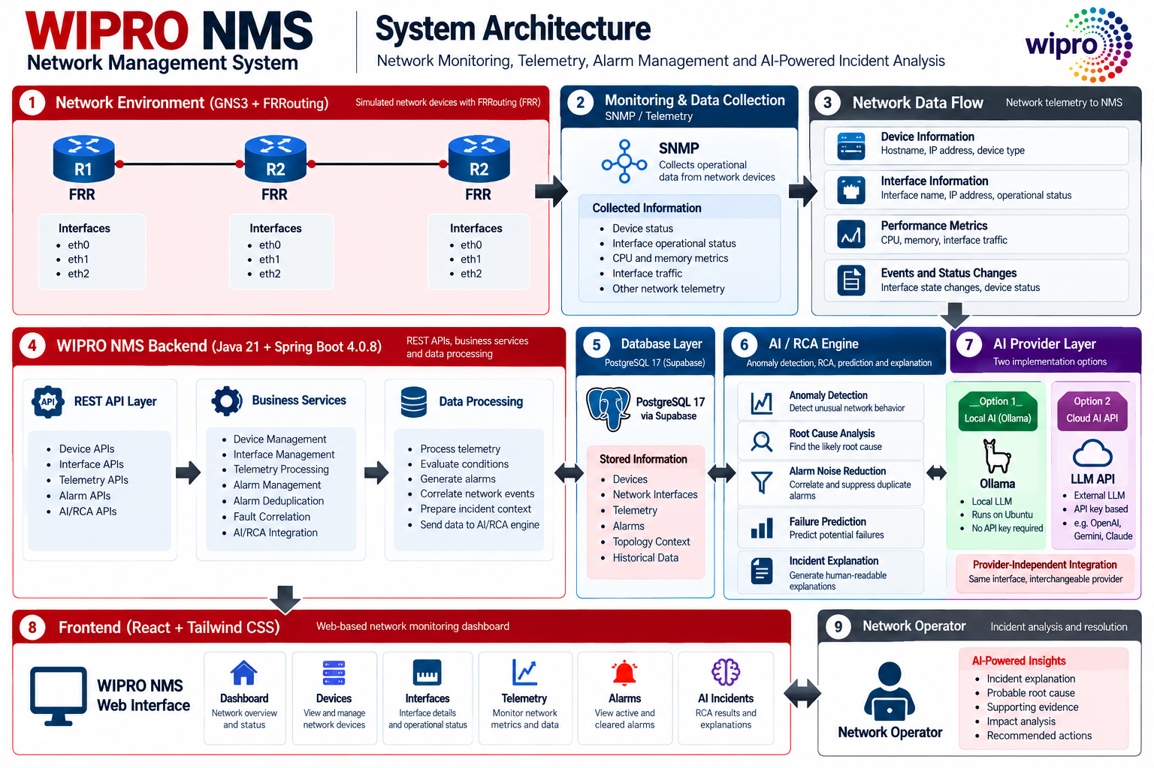
SYSTEM ARCHITECTURE
WIPRO NMS — System Architecture
SYSTEM ARCHITECURE
GNS3 / FRRouting → SNMP / Telemetry → Spring Boot Backend → PostgreSQL Database → REST API → React Dashboard
Technology Summary
Network
Backend
GNS3 • FRRouting • SNMP
• AI Provider Layer • API
Java 21 • Spring Boot 4.0.8 • Spring Data JPA • Hibernate
Database
Frontend
PostgreSQL 17 • Supabase • HikariCP
React • Tailwind CSS

Slide 6

EXISTING SYSTEM
Existing System and Its Limitations
In a conventional or distributed monitoring environment, administrators may need to inspect individual network devices and interfaces to understand their operational state. Information can be distributed across different devices or monitoring sources, making centralized visibility difficult.
Existing Approach
WIPRO NMS — Improved Approach
Network Devices → Individual Monitoring → Manual Status Checking → Manual Fault Identification → Separate Information
Multiple devices → Centralized monitoring → Telemetry processing → Structured alarms → Unified dashboard
Limited Centralized Visibility
Manual Monitoring Effort
Centralized Visibility
Automated Monitoring
Network information is not necessarily available through one unified operational interface.
Administrators may need to inspect individual devices and interfaces.
All devices and interfaces visible from one unified dashboard.
Continuous telemetry collection replaces manual status checking.
Structured Alarm Lifecycle
Delayed Fault Awareness
Difficult Alarm Tracking
Immediate Fault Detection
Alarms are created, updated, and cleared with full timestamp tracking.
Operational changes may not be identified immediately without continuous monitoring.
Without structured alarm lifecycle management, active and resolved faults are harder to track.
Alarm engine detects and records faults as they occur.
Limited Data Organization
Higher Monitoring Effort
Telemetry and operational information need to be consistently organized for monitoring and historical review.
As the number of devices and interfaces increases, checking each component individually becomes more difficult.
WIPRO NMS brings network devices, operational data, telemetry, and alarm management into a centralized monitoring platform.

Slide 7

METHODOLOGY & TECHNOLOGY
Methodology and Technology Stack
Development Methodology
Technology Stack
01
Network & Simulation
Backend
Requirement Analysis
GNS3 • FRRouting (FRR) • SNMP
Java 21 • Spring Boot 4.0.8 • Spring Data JPA • Hibernate ORM • Maven
Identify requirements for device management, interface monitoring, telemetry, alarm management, and dashboard visualization.
02
Database
Frontend
Network Environment Setup
PostgreSQL 17 • Supabase • HikariCP
React • Tailwind CSS • REST / JSON
Build the virtual network topology using GNS3 + FRRouting.
AI Local/ Provider Layer
03
Runtime
Ollama + Local LLM • External LLM API
Backend Development
Apache Tomcat 11 • Linux / Ubuntu
Develop the backend using Java 21 + Spring Boot 4.0.8. Implement REST APIs, services, and persistence.
04
Final Outputs
AI/RCA Engine
Telemetry Processing
Process monitoring information and associate it with the relevant device/interface.
RCA, explanation, recommendation
Central decision engine
05
Alarm Implementation
Implement: Detection → Creation → Update → Clearing.
AI/RCA Engine Architecture
06
AI Analysis
AI Provider Abstraction
Database Integration
Correlation and inference
Unified interface layer
Persist Devices, Interfaces, Telemetry, and Alarms using PostgreSQL.
07
Frontend Development
Build the monitoring dashboard using React + Tailwind CSS.
Cloud AI (LLM API)
Local AI (Ollama)
08
AI-Powered Network Intelligence
External API with key
On-premise local model
Analyzes network and alarms to detect anomalies, root-cause analysis, reduce alarm noise and explain incidents to the operator.

Slide 8
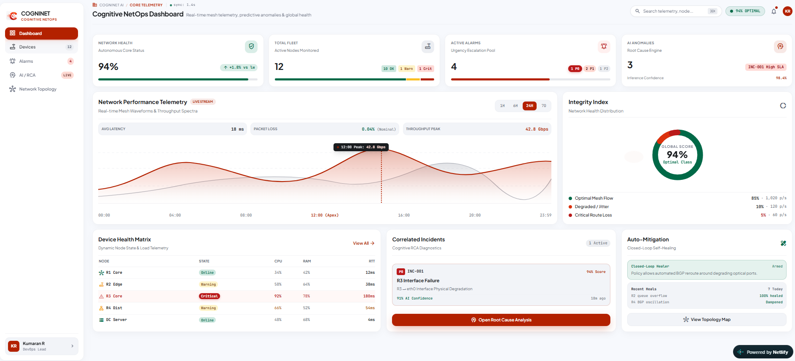
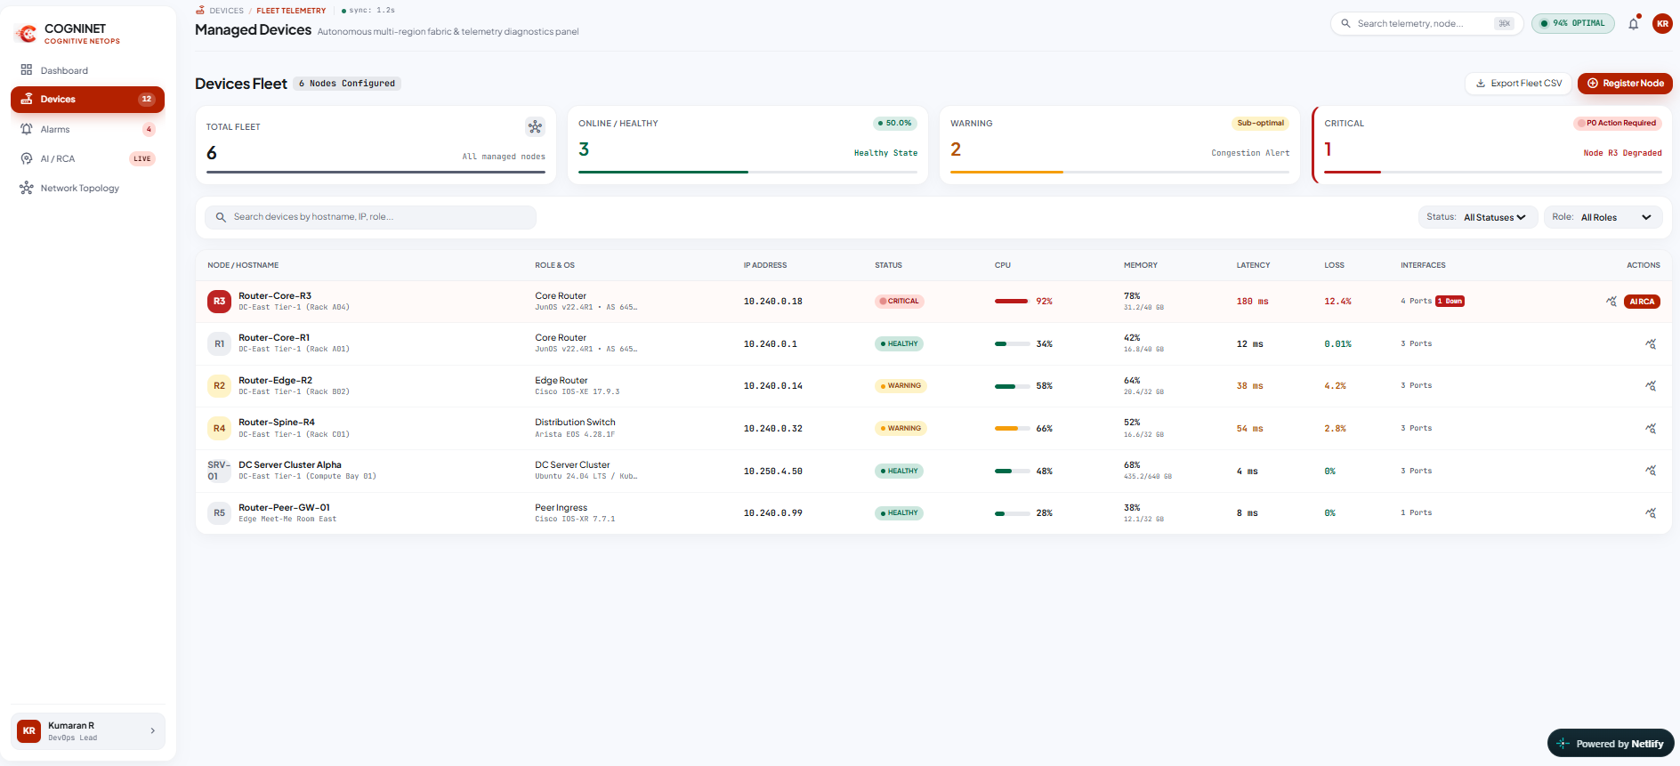
FRONTEND
WIPRO NMS — Implementation I
Web-Based Network Monitoring Interface
The React frontend consumes REST APIs exposed by the Spring Boot backend and presents processed network information through a unified monitoring dashboard. The interface provides centralized views of network status, device and interface management, and telemetry and alarm monitoring.
Dashboard / Network Overview
Centralized view of network status and monitoring information.
Device and Interface Management
View and manage registered network devices and interfaces.
React
Tailwind CSS
REST API

Slide 9
BACKEND
WIPRO NMS —Implementation II
REST APIs, Telemetry Processing and Alarm Management
The Spring Boot backend acts as the central application layer, providing REST APIs and application services for device management, interface management, telemetry processing, and alarm management. The backend receives requests and monitoring information, applies business logic, and communicates with persistent storage.
Alarm Management / API Response
Backend alarm creation, status management, and clearing.
Telemetry Processing
Backend processing and persistence of network monitoring information.
Java 21
Spring Boot 4.0.8
REST API
JPA
Hibernate
PostgreSQL 17

Slide 10
THANK YOU
WIPRO NMS CAPSTONE PROJECT
Network Management System — Capstone Project
Project Team
Guided By
Technology Summary
230701138 — Kamalesh SP
230701158 — Kumaran R
230701414 — Ganesh M
[MENTOR NAME]
GNS3 • FRRouting • SNMP • Java 21 • Spring Boot 4.0.8 • Spring Data JPA • Hibernate ORM • Maven • Apache Tomcat 11 • PostgreSQL 17 • Supabase • HikariCP • React • Tailwind CSS • REST / JSON • LOCAL AI LLM • ExternalAPI
[RAJALAKSHMI ENGINEERING COLLEGE] · [COMPUTER SCIENCE AND ENGINEERING]

